Slide 1
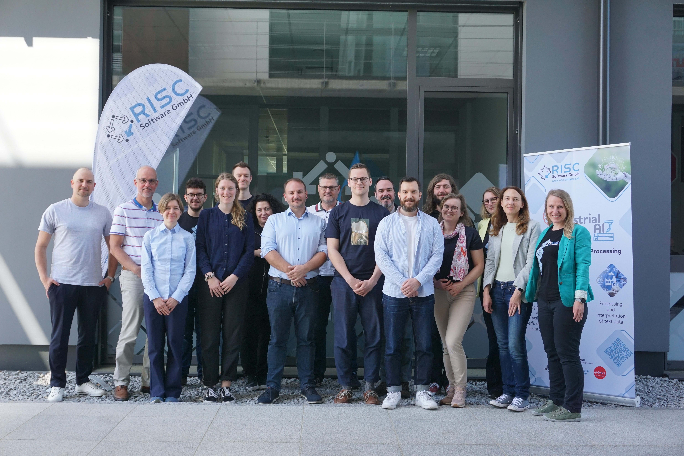
Vorhersage und Optimierung von Stromlasten mit KI-gestützten Prognosemodellen für kostengünstige und versorgungseffiziente Stromnetze
Herausforderung & Motivation
Unzureichende Genauigkeit aktueller Vorhersagemodelle für die volatile Stromproduktion wie Wind- und Solarenergie
Belastung der Netzstabilität
Finanzielle Auswirkungen für Endverbraucher
Ziel
Entwicklung von KI-gestützten Modellen zur Vorhersage von Stromlasten
Lösung
Neuartige KI-Modelle basierend auf adaptivem Lernen
Berücksichtigung verschiedener Daten- und Informationsquellen
Auswirkungen und Nachhaltigkeit
Bewältigung der aktuellen Herausforderungen im Bereich der Stromnetzoptimierung
Verbesserung der Nachhaltigkeit des Energiesystems
Leitung: RISC Software GmbH
Partner:
Energieinstitut der JKU
HAKOM Time Series
LINZ NETZ GmbH
Austrian Power Grid AG
Links:
FFG-Projektseite
Website
Call AI4GREEN 2023
Laufzeit 04.2024 – 03.2027
Budget 783.357 EUR
Davon Förderung 618.489 EUR
Technische Projektleitung: Dominik Falkner, dominik.falkner@risc-software.at
Projektleitung: Stefanie Kritzinger-Griebler, stefanie.kritzinger-griebler@risc-software.at

Slide 2
POWERCAST Big Pic

Slide 3
Notes:
AI Research (PM-G#1 & PM-G#2):
• Through adaptive learning methods, such as transfer learning and online learning, and the inclusion of multiple information sources, more dynamic and accurate load forecasts will be enabled. This will be powered by a multimodal data set acquired via a newly developed data fusion pipeline with access to, amongst others, microgeographic data from Panadress marketing intelligence GmbH and load data from NETZ. (WP2 – 4)
• The contribution of renewable energy outputs to load profiles is very hard to quantify. Through POWERCAST, emphasis will be placed on developing a novel PV output prediction model, which can be validated via access to valuable inverter data through APG and Fronius International GmbH. Once developed, this model will be used to quantify the contribution of renewable energy in the forecasted load profiles. (WP4)
Sustainability (NM-G#1 & NM-G#2):
• POWERCAST’s improved load forecast (UC-G#1) facilitates more efficient energy usage, enabling the inclusion of larger amounts of renewable energy into today’s power grids and leading to the reduction of energy costs and overall facilitating decarbonization (WP5, WP7).
• Forecasted load profiles will be analyzed for extreme loads and their contributing factors (UC-G#2). This in combination with custom visualizations provides grid operators with detailed insights on critical situations in the existing grid, thus allowing counteraction and a more efficient and sustainable energy infrastructure development (WP6).
POWERCAST focuses specifically on challenges faced by grid operators in Austria and other European countries. The aim is to greatly improve the state-of-the-art forecasting methods via strong cooperation between research, industry, and experts in the field of grid management (NETZ, APG, EI) as well as data management and science (HAKOM, RISC). Through publications in relevant renowned journals and active dissemination of results, POWERCAST enables non-consortia parties to apply and further develop the POWERCAST model. POWERCAST will not pose any risks listed in the EU AI Act and thus is to be classified as “minimal risk”.
POWERCAST will develop new data sets and data fusion infrastructure as well as visualization and modelling tools. The results achieved through interdisciplinary work will impact end consumers in several ways: Reduced electricity costs in the long-term will benefit especially people of a lower income class (see 1.2). However, end consumers of (at least) the middle-income class will additionally benefit from an increase of the feed-in rate and a higher approval quota of residential PV.
In return, a higher demand for PV panels and subsequently higher market competition will reduce PV panel costs in the long term, enabling people of a lower income class to install their own PV panels (see 3.1). Potential rebound effects may include higher electricity consumption or increase in spendings in GHG-intense goods, both due to lower electricity costs.

